Slide 1
Seeking A Rights-Based System for Migration
Megan A. Carney, Ph.D.
University of Washington, Seattle

Slide 2
Deservingness
an assessment of both the explicit qualifications (income, family size, age, disability, legal status) and the implicit qualifications (race, gender) that articulate with other aspects of individual identity

Slide 3
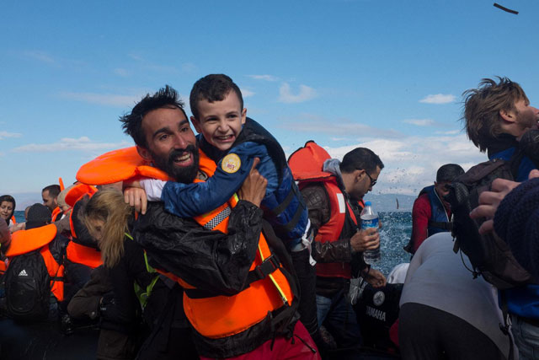
Humanitarianism and “Legitimate” Forms of Suffering
The Case of Refugees and Asylum-Seekers
Source: UNICEF 2015

Slide 4
A Human Rights Approach to Migration
“A human rights approach to migration places the migrant at the centre of migration policies and management, and pays particular attention to the situation of marginalised and disadvantaged groups of migrants […]
Human rights mechanisms, such as the Special Rapporteur on the Human Rights of Migrants and the Committee on Migrant Workers, have been clear in stating that although countries have a sovereign right to determine conditions of entry and stay in their territories, they also have an obligation to respect, protect and fulfill the human rights of all individuals under their jurisdiction, regardless of their nationality or origin and regardless of their immigration status.”
Source: UN Office of the High Commissioner

Slide 5
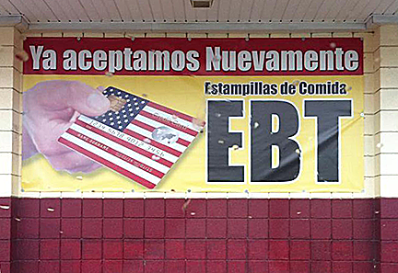
Needs-Based Approaches
Eligibility for public programs based on income, e.g. food stamps/food vouchers.

Slide 6
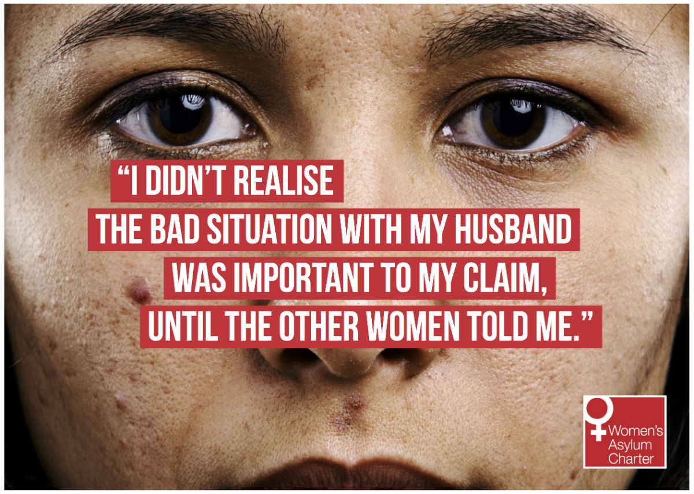
Performing Victimhood and Potential for Re-traumatization
Source: Asylum Aid

Slide 7
Research Methodology
Deeply qualitative; access the lived experience
Feminist ethnography
Democratize knowledge production
Dismantle conventional power dynamics of research
Frame work as a collaboration through participatory methods
Facilitate auto-ethnography

Slide 8
Case Study:
Food Insecurity and Migration from Mexico and Central America to the United States

Slide 9
Causes and Differential Effects of Food Insecurity
Trade liberalization puts local communities at economic risk
NAFTA and CAFTA in the Mexico and Central America context
Corporatization of the food system strips people of power over how food is produced and distributed
Food as commodity vs. food as a human right
Migration is one strategy or “invisible adjustment” of many in responding to food insecurity
Gendered division of labor assigns food procurement, preparation, and allocation to women – they are the first to feel the effects of this system.

Slide 10
“Allá no tenemos nada de comer.”
Back there we had nothing to eat.

Slide 11
“Linda” Mother of 3, from Michoácan, Mexico Undocumented
“If one desires fruit or vegetables, one must buy them and our parents didn’t have enough money to buy. We ate almost no meat because it was very expensive. So we ate beans, chilies, tortillas; this is what one ate most because we didn’t have money for fruits and vegetables.”

Slide 12
“Luisa” Mother of 2, from Michoácan, Mexico Undocumented
“Here [in the United States], you don’t lack for an apple, an orange, fruit, anything. In Mexico, it is very different. In Mexico they raised us on beans. When she could, our mom bought us a piece of cheese and chilies in vinegar to add to our meal. . . . When they had money they sometimes bought us soup or meat. But very little meat because it was so expensive and our parents didn’t have the money to buy it for us. We ate whatever there was for us to eat.”

Slide 13
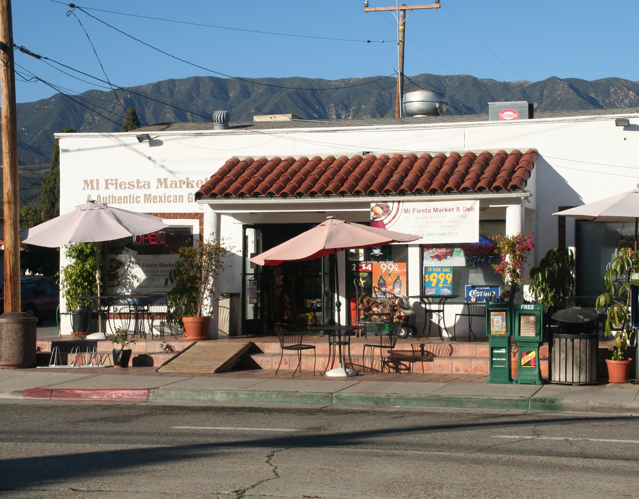
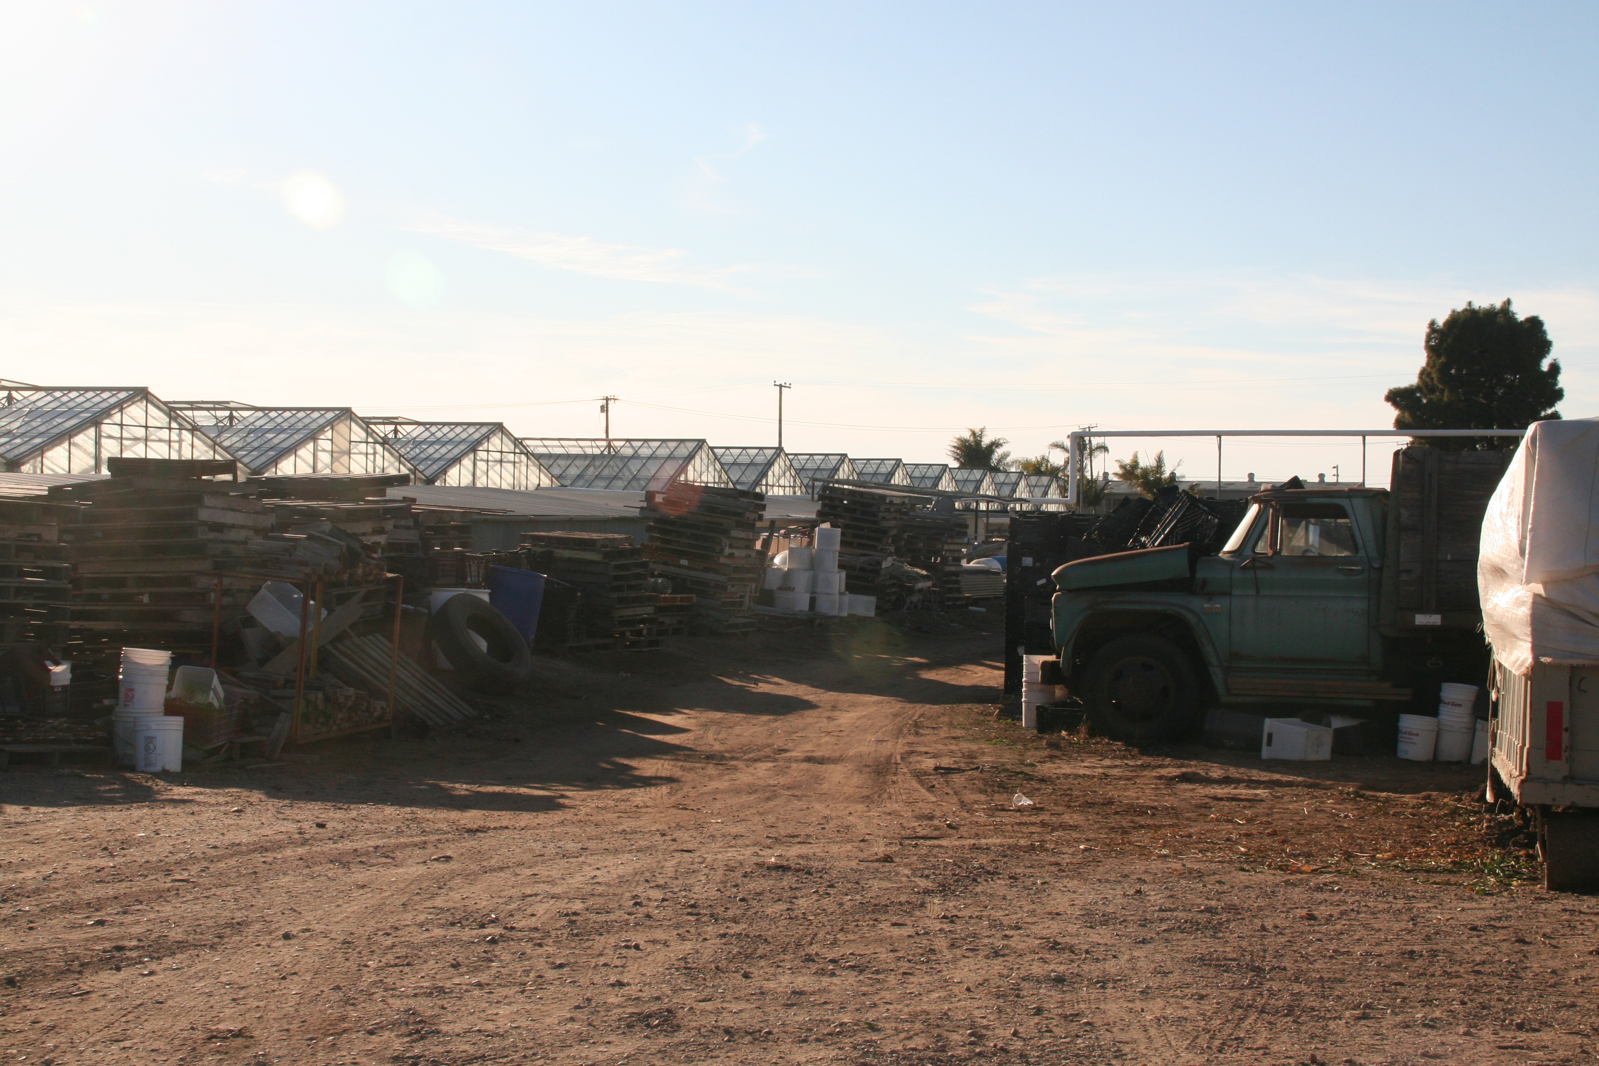
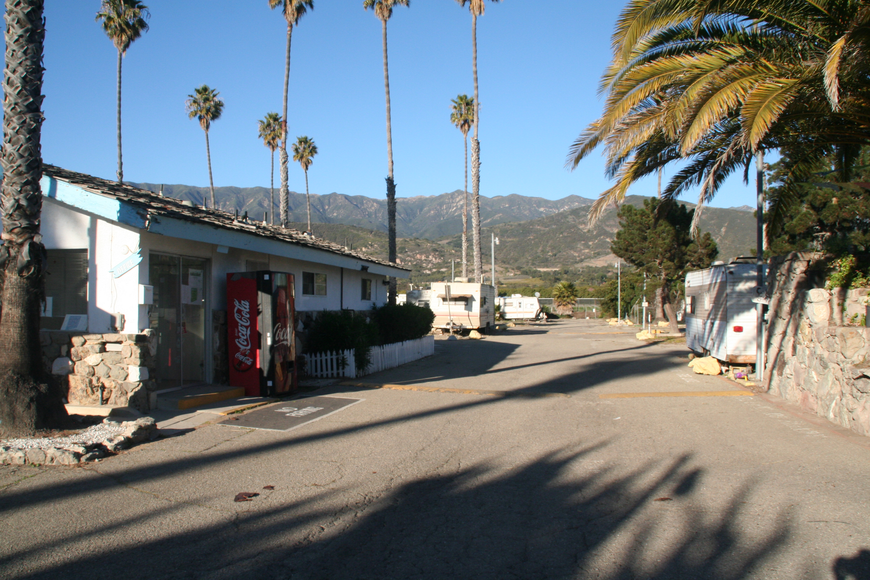
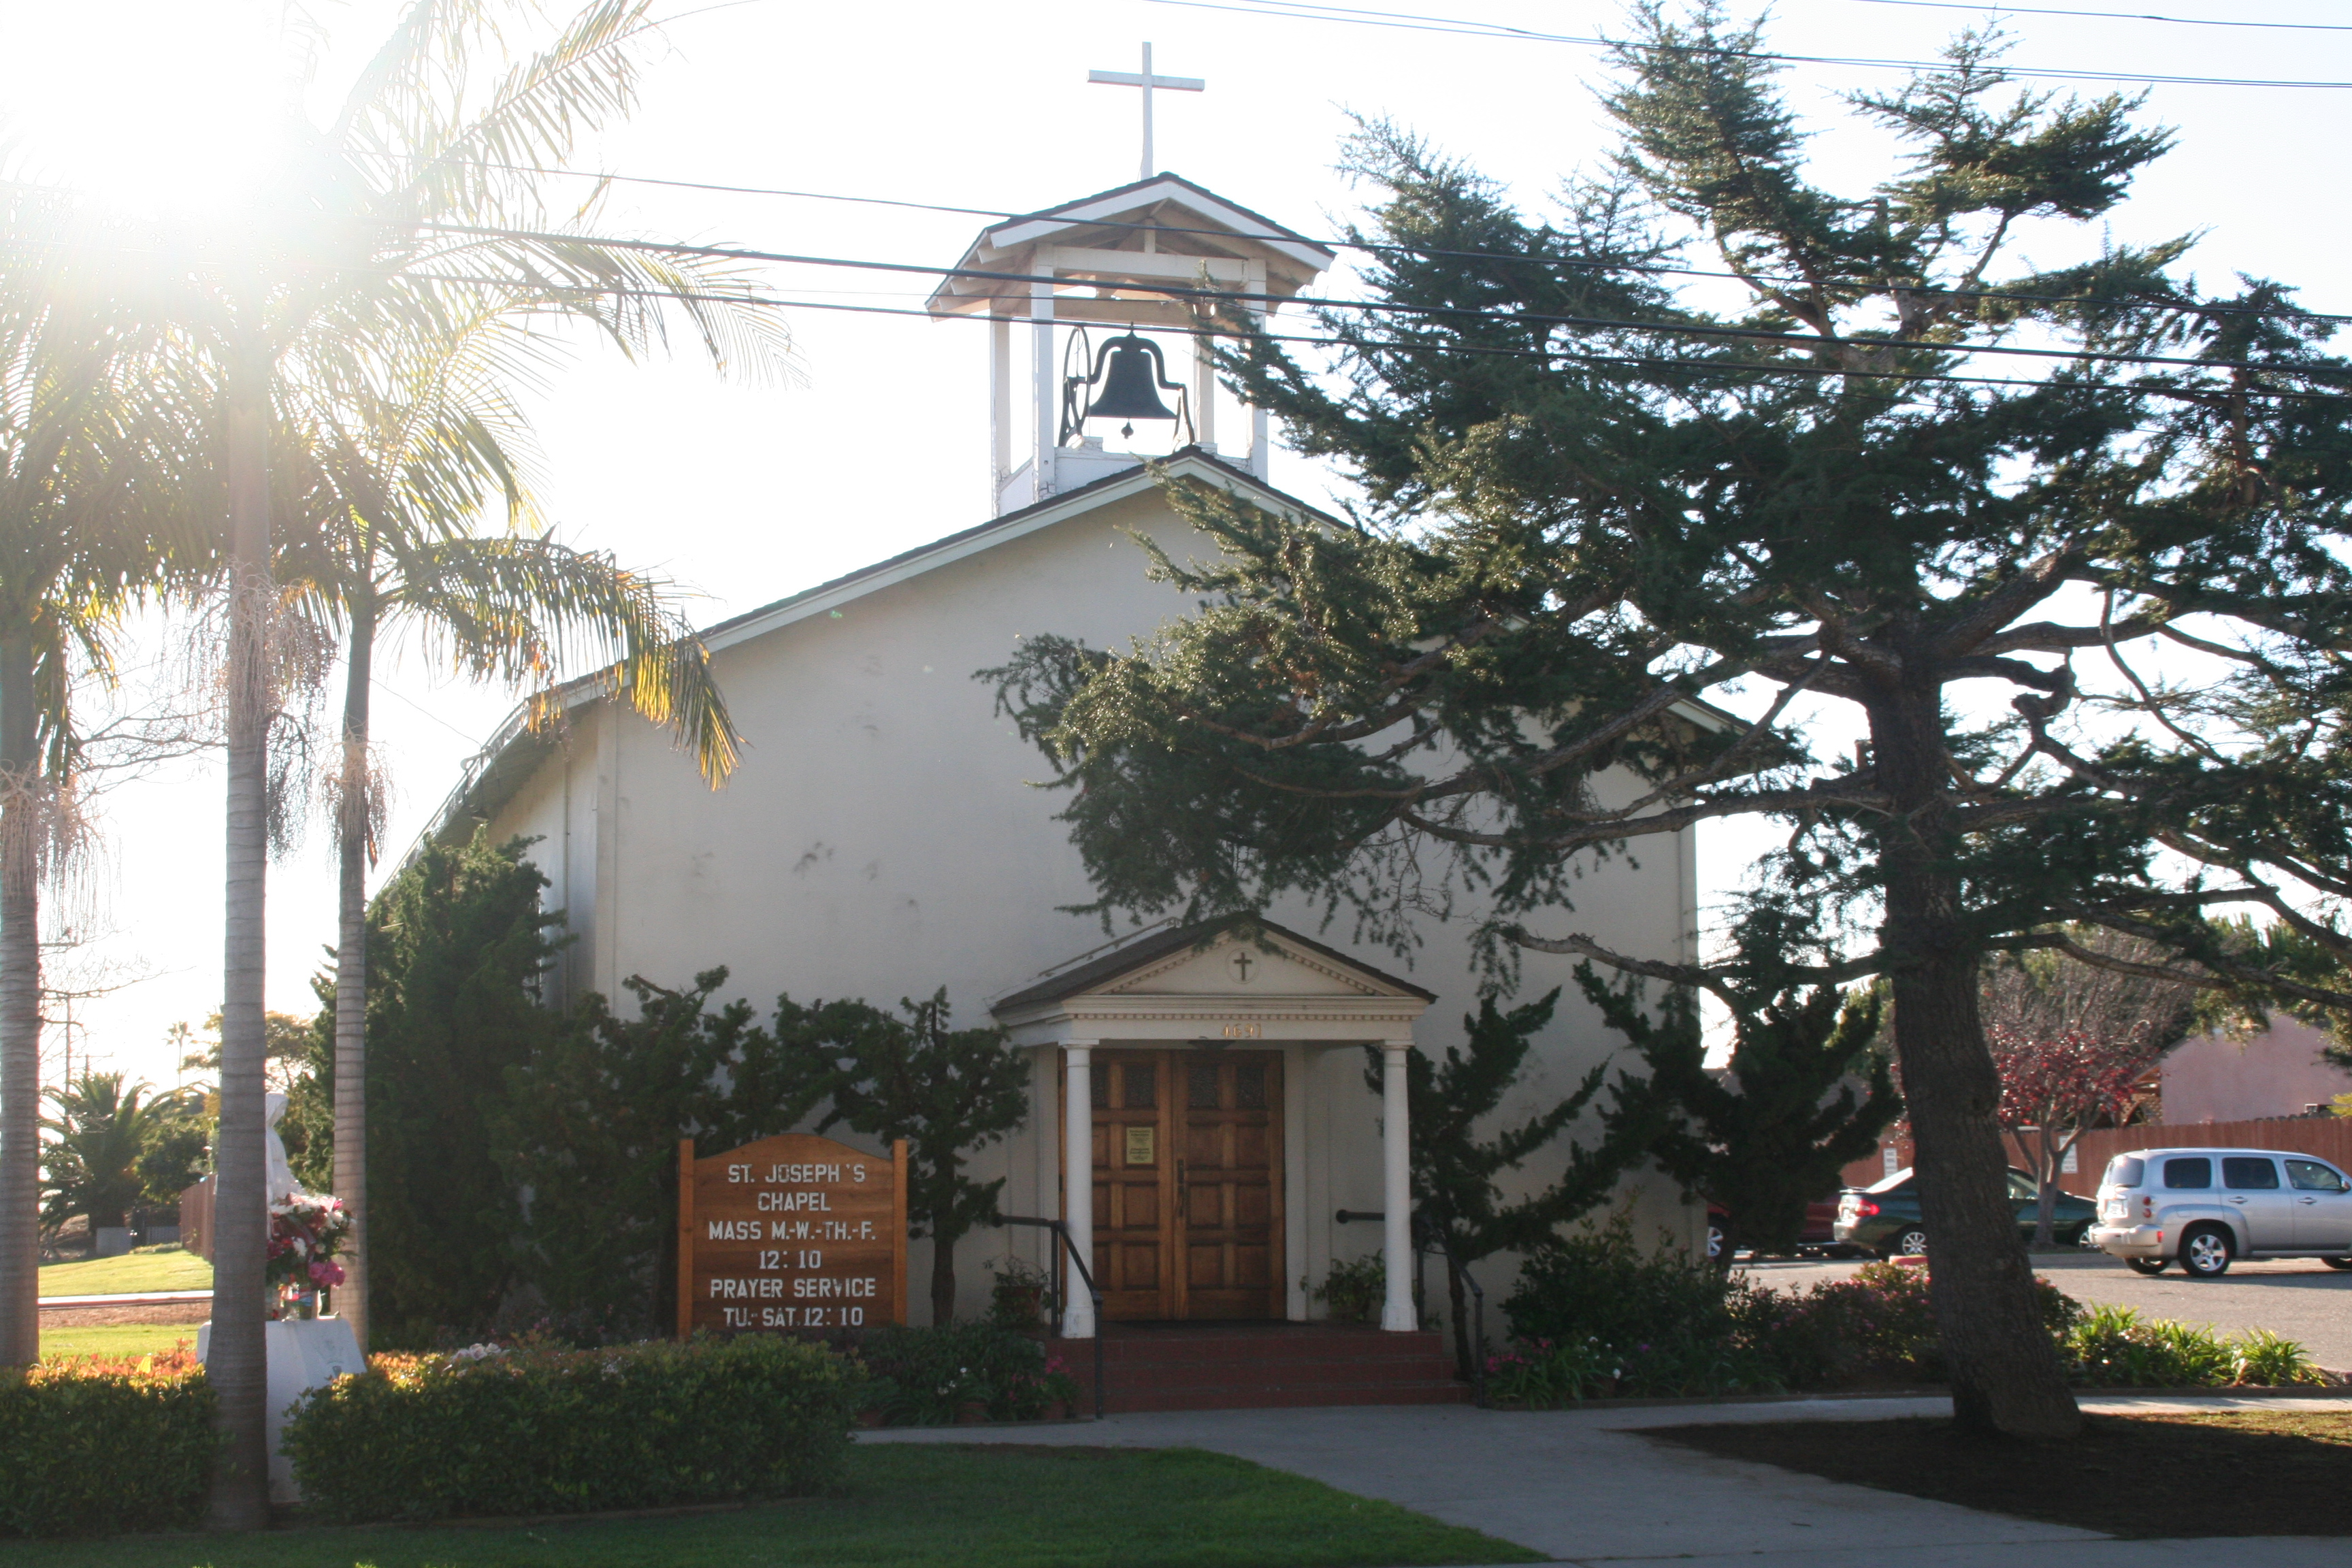

Slide 14
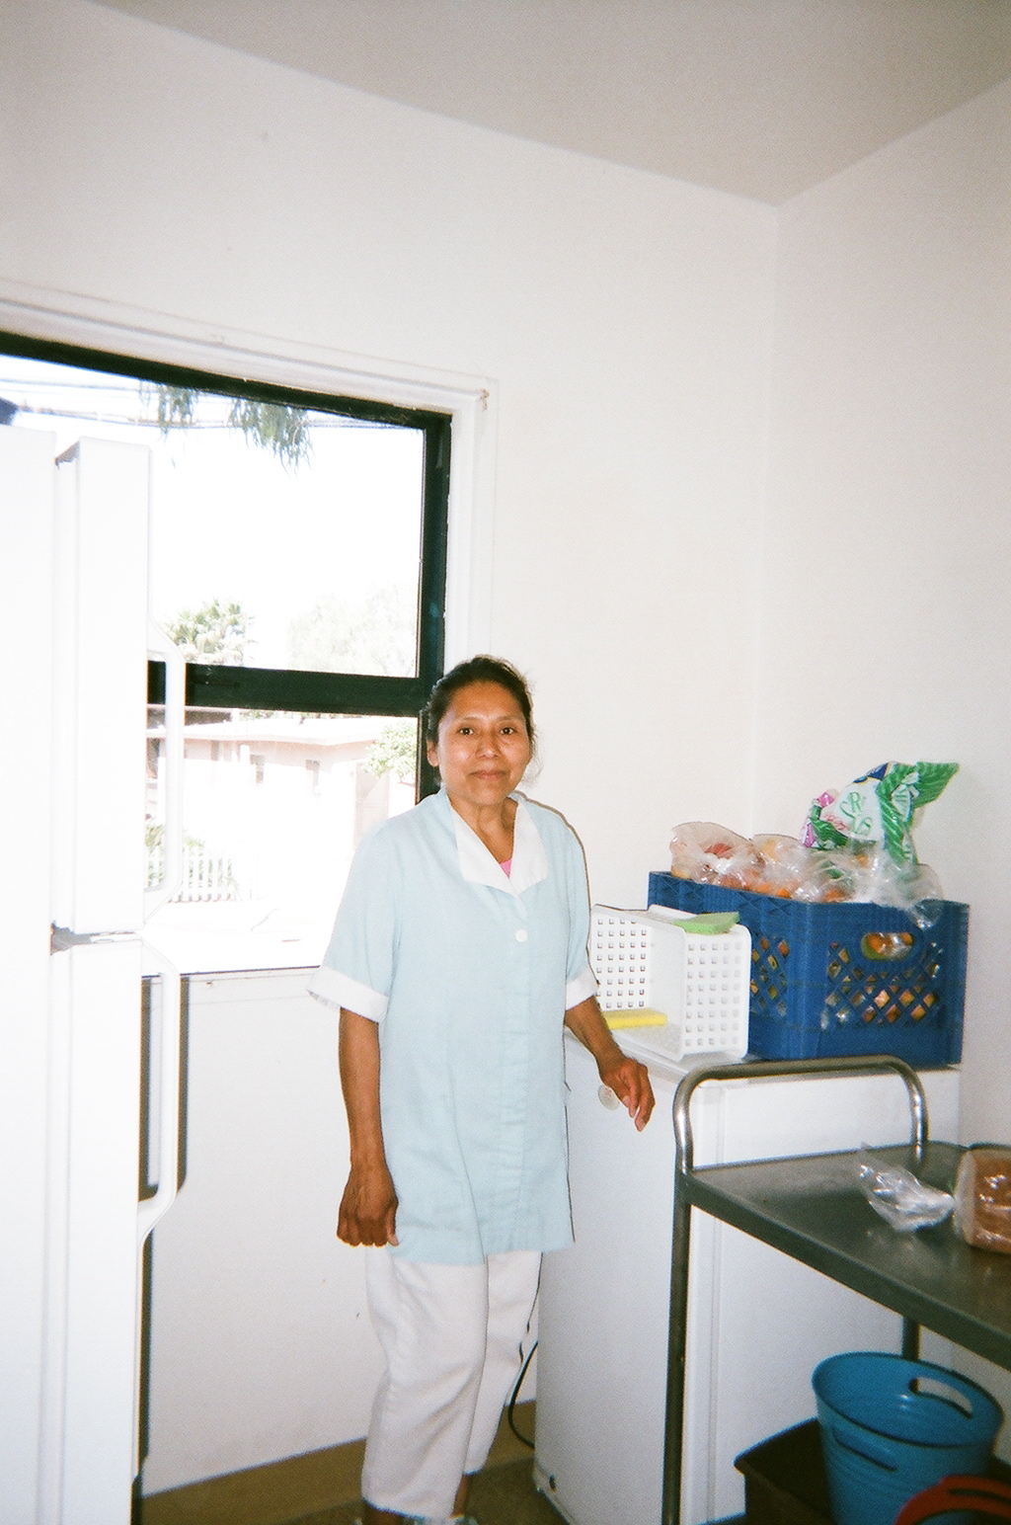
“Malena” Mother of 4, from Guerrero, Mexico
Undocumented

Slide 15
“Malena”
“The debt that I had there [in Mexico] . . . this is what was worrying me. So I thought and said, ‘When I am going to pay this money?’ So, I thought and thought only of this, and I had faith and hope that I’d arrive here [in the United States]. Ultimately I was thinking of work because I came to work, to find a job.”

Slide 16
Revisiting Deservingness
“Tiers” of suffering actualized in migration policies problematic for social equality;
Why doesn’t food insecurity factor into current migration policy?
Environmental displacement highly likely to worsen with climate change.

Slide 17
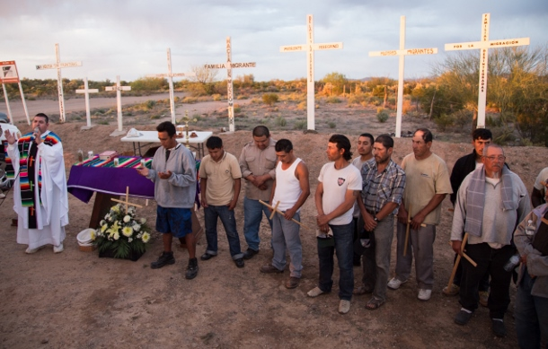
“Borderlands as Battlegrounds” Violence in the Lives of Migrants
Source: Waging Nonviolence 2015

Slide 18
“Camila” Mother of 4, from Acapulco, Mexico Undocumented
“[My patrona] mistreated me so much, yelled so much at me. While I really needed the work and I felt so affectionate toward the children, I simply could not bear it anymore.”

Slide 19
Case Study:
Immigrant Detention in the United States

Slide 20
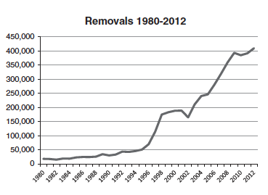
Source: Golash-Boza and Hondagneu-Sotelo 2013

Slide 21
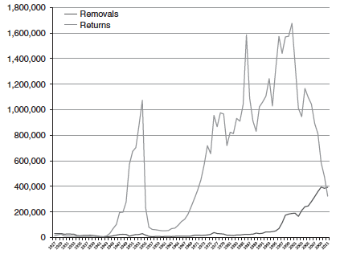
Source: Golash-Boza and Hondagneu-Sotelo 2013

Slide 22
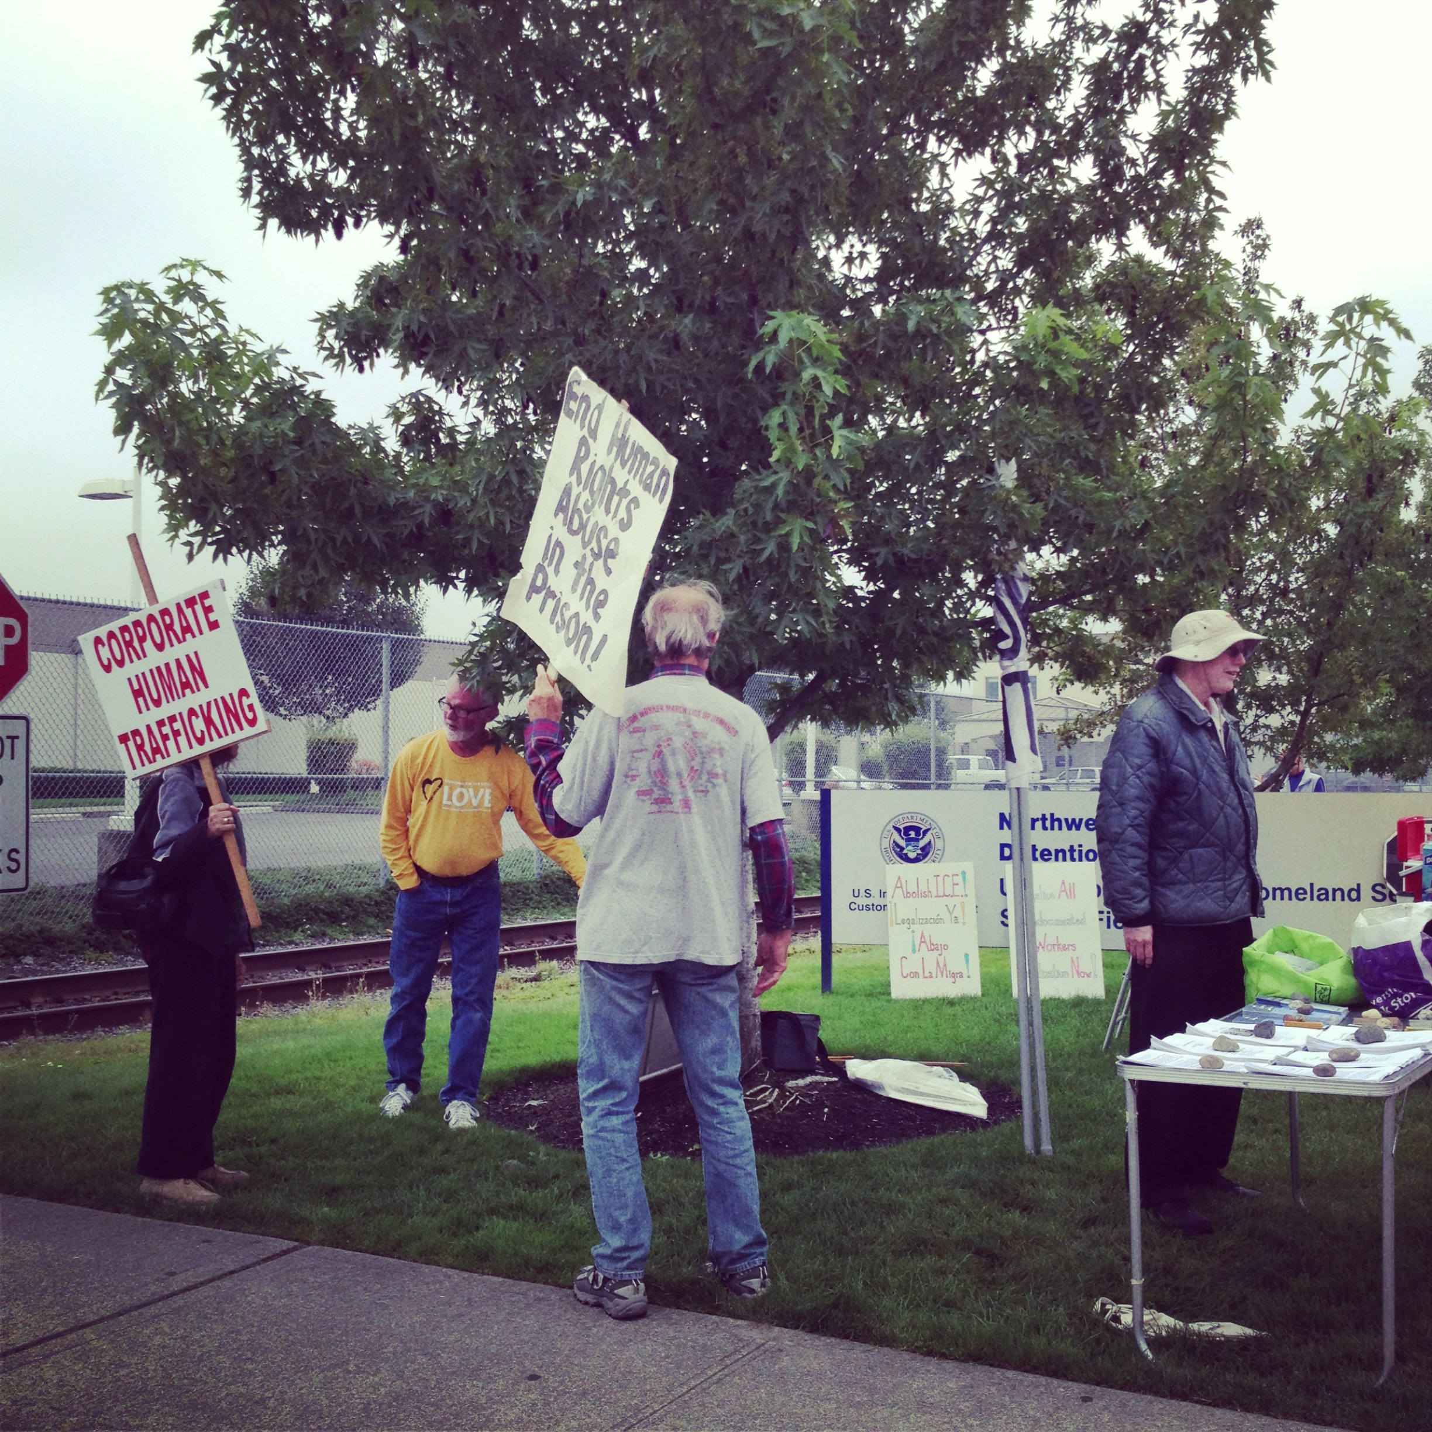
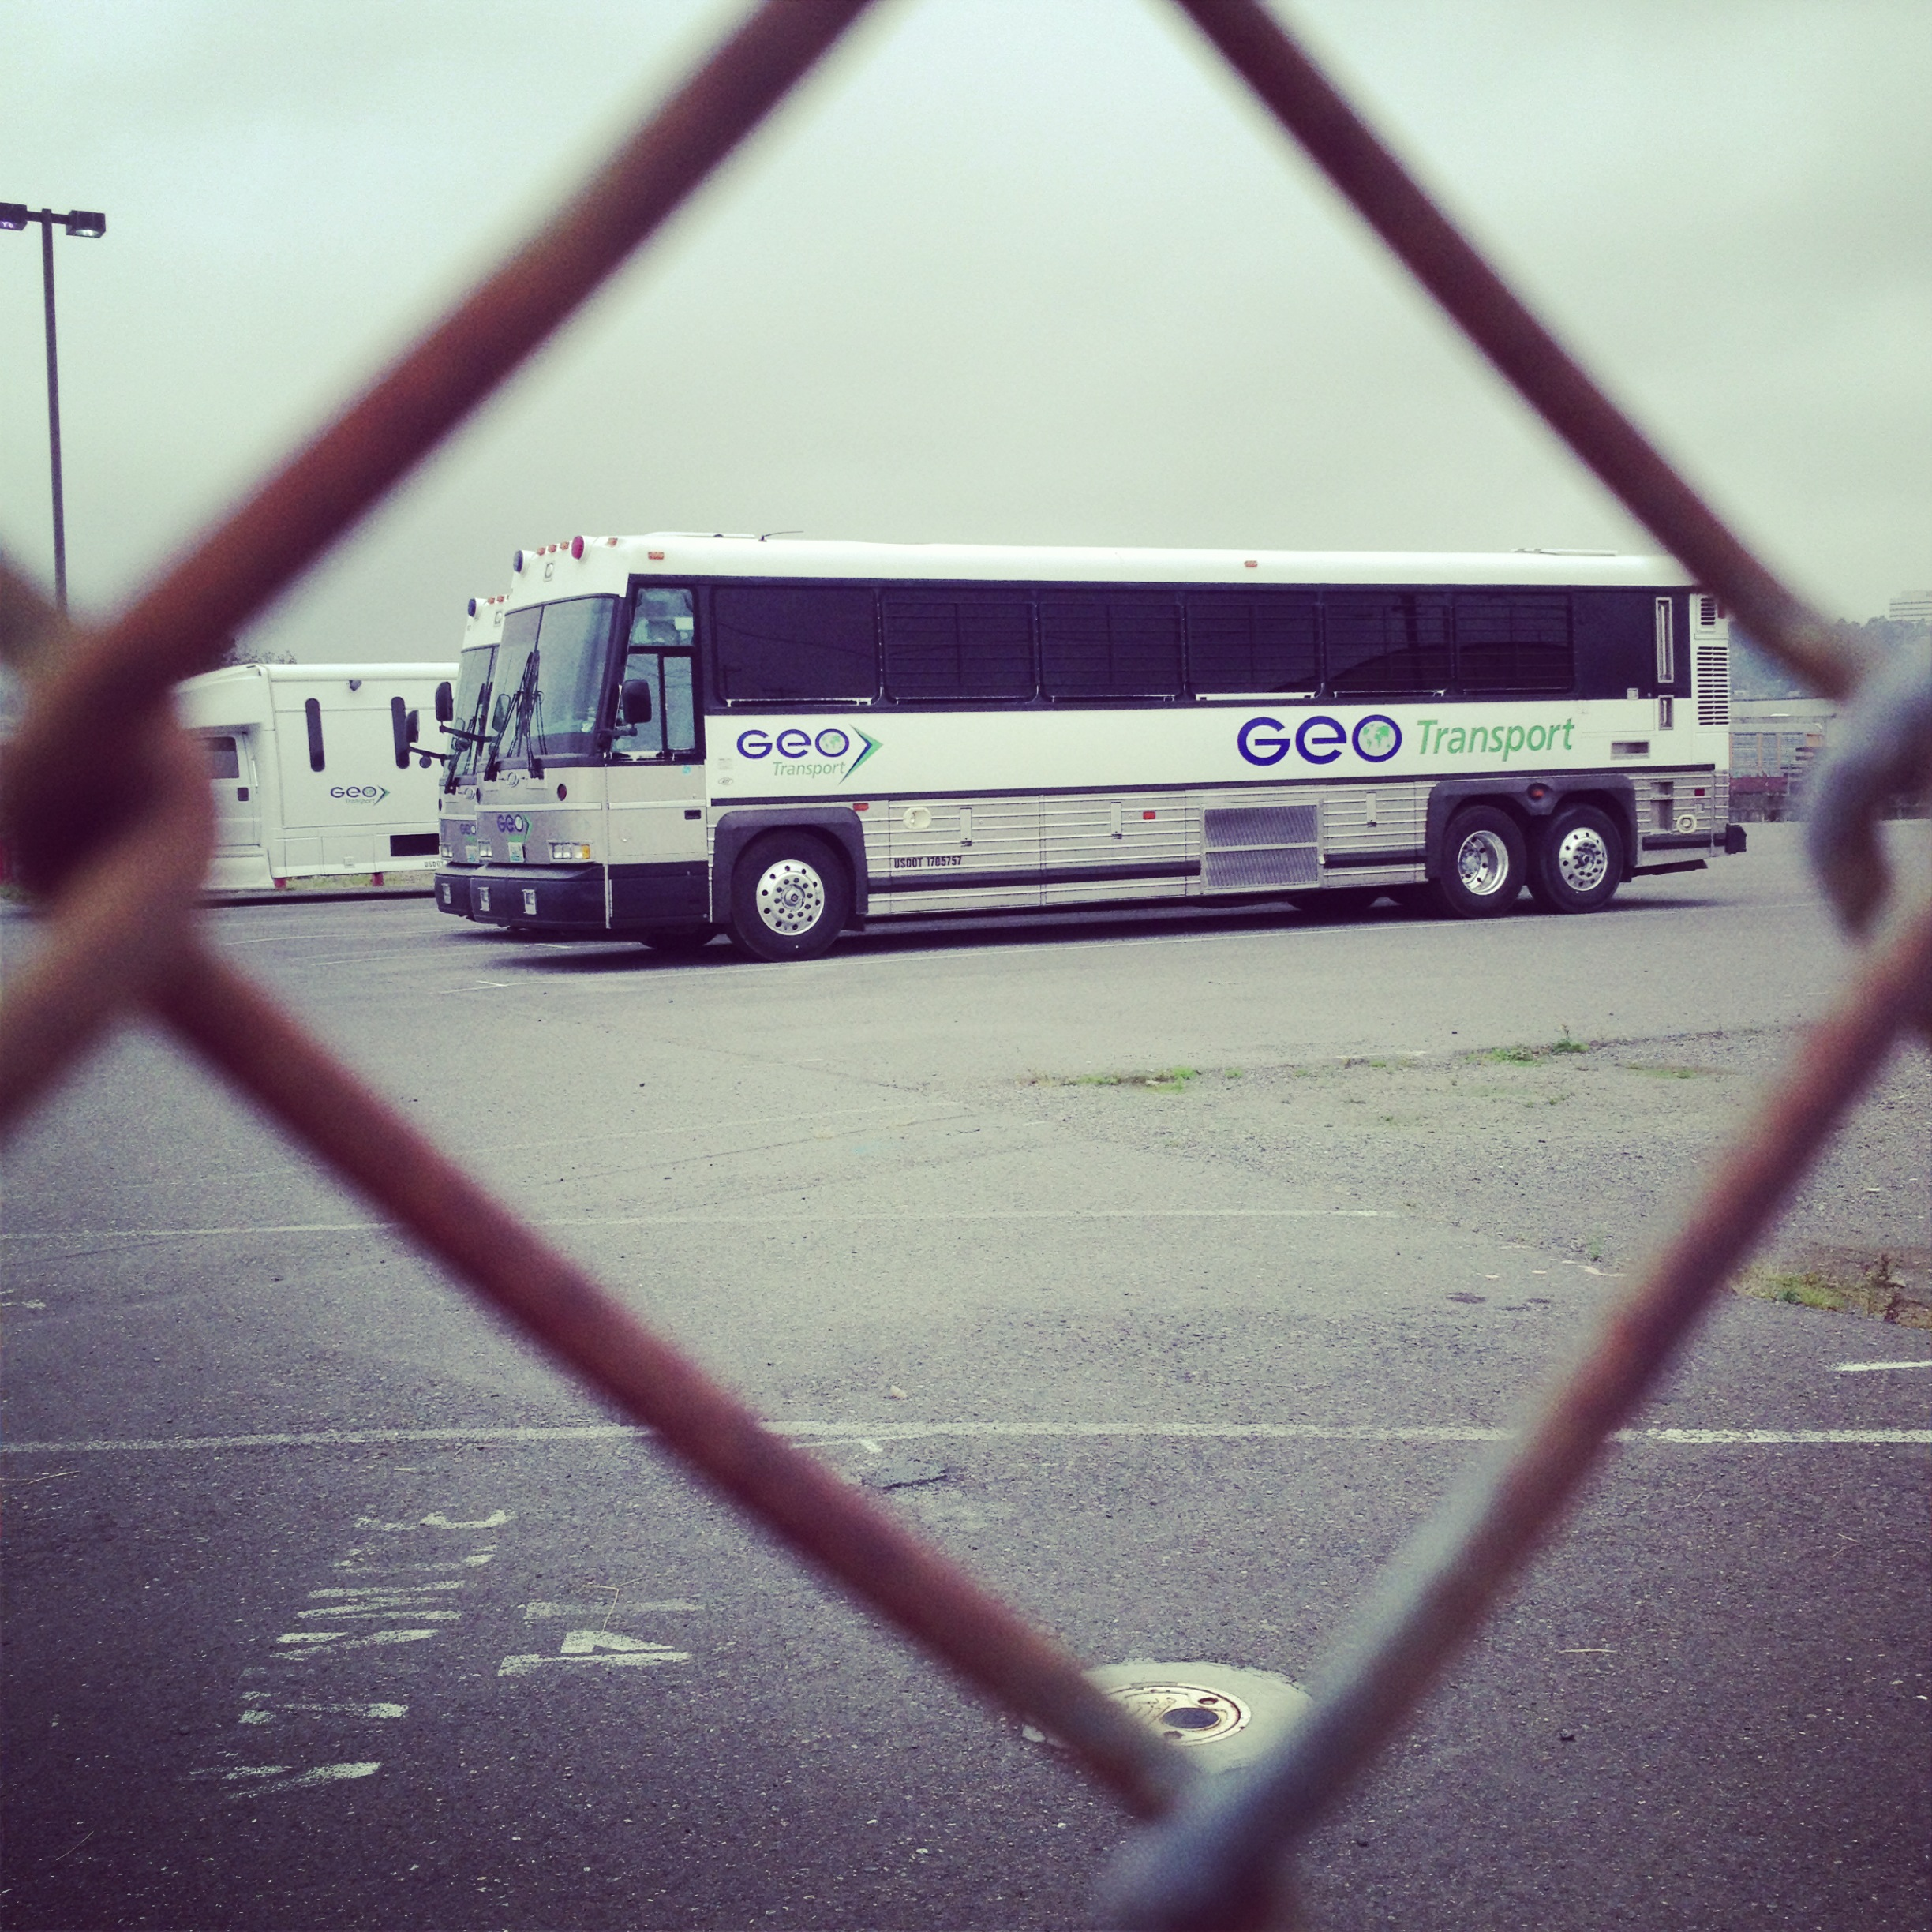
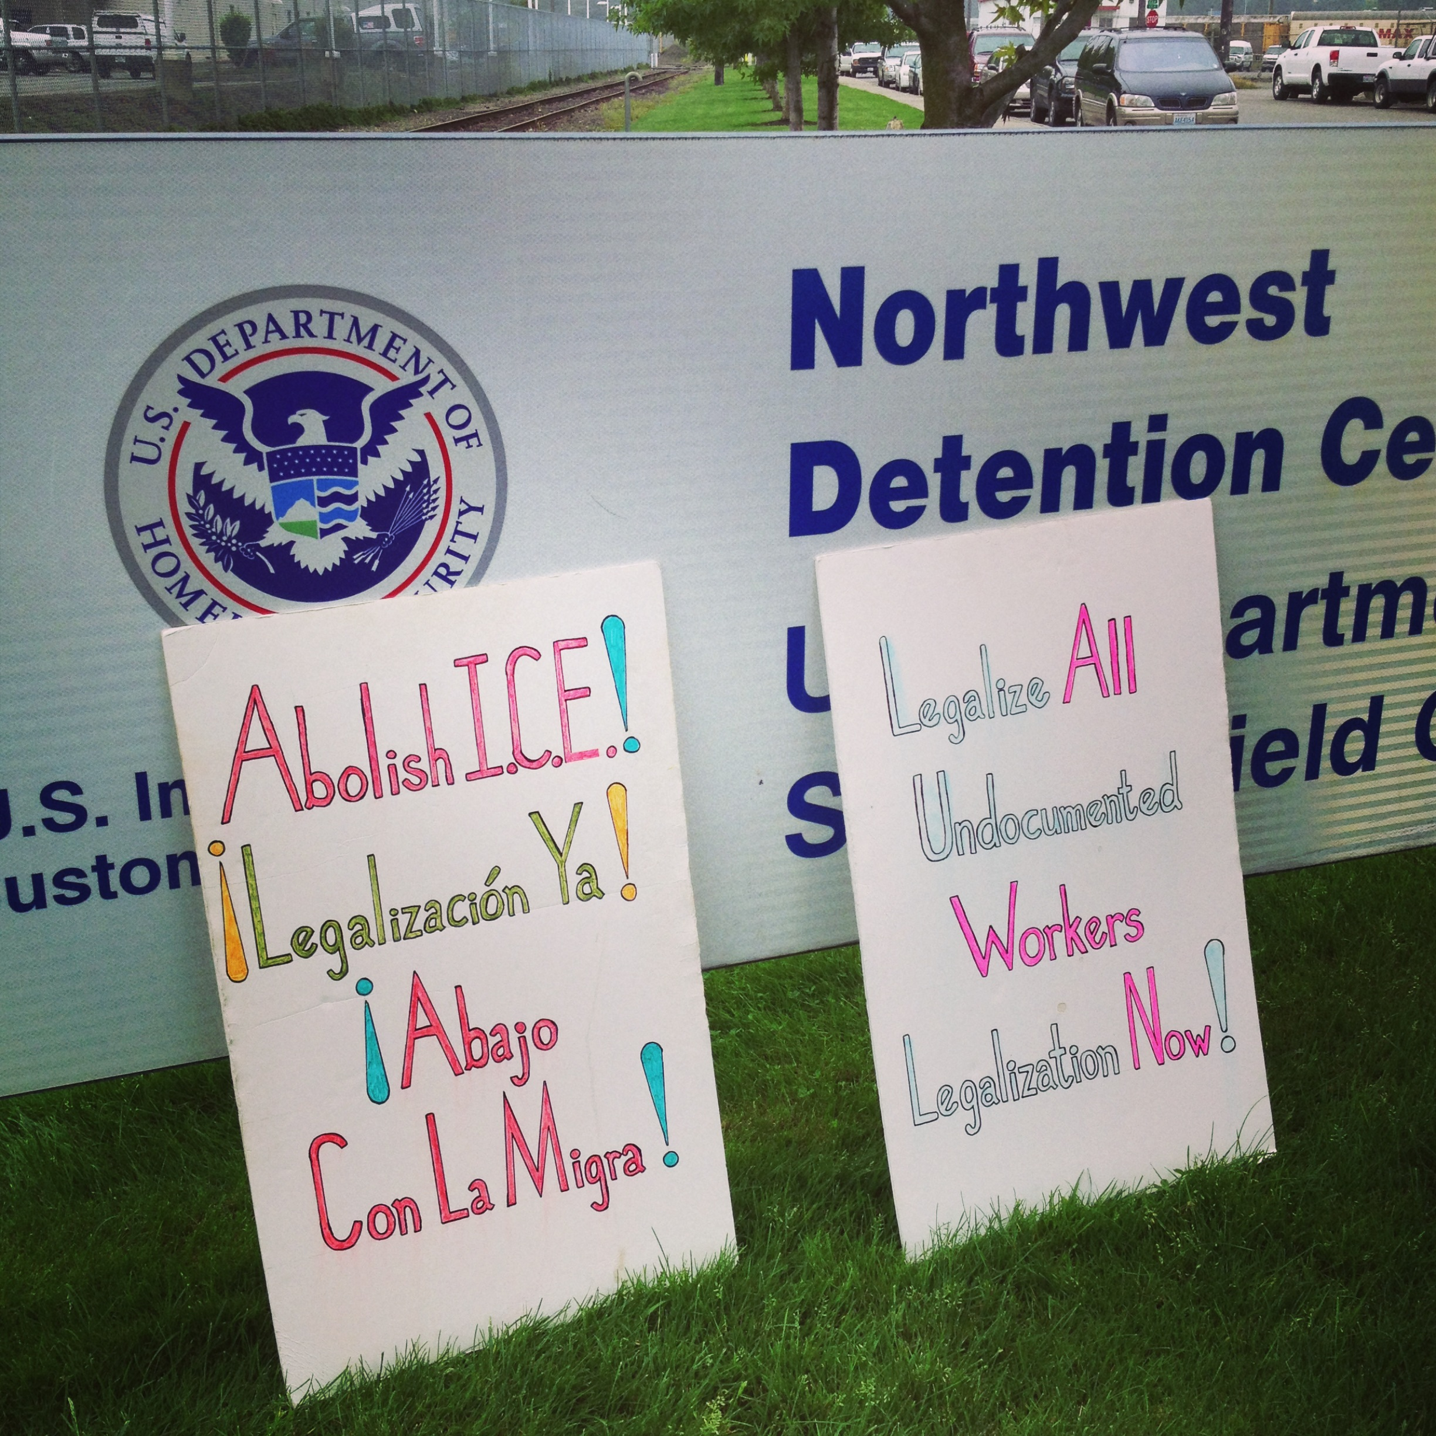
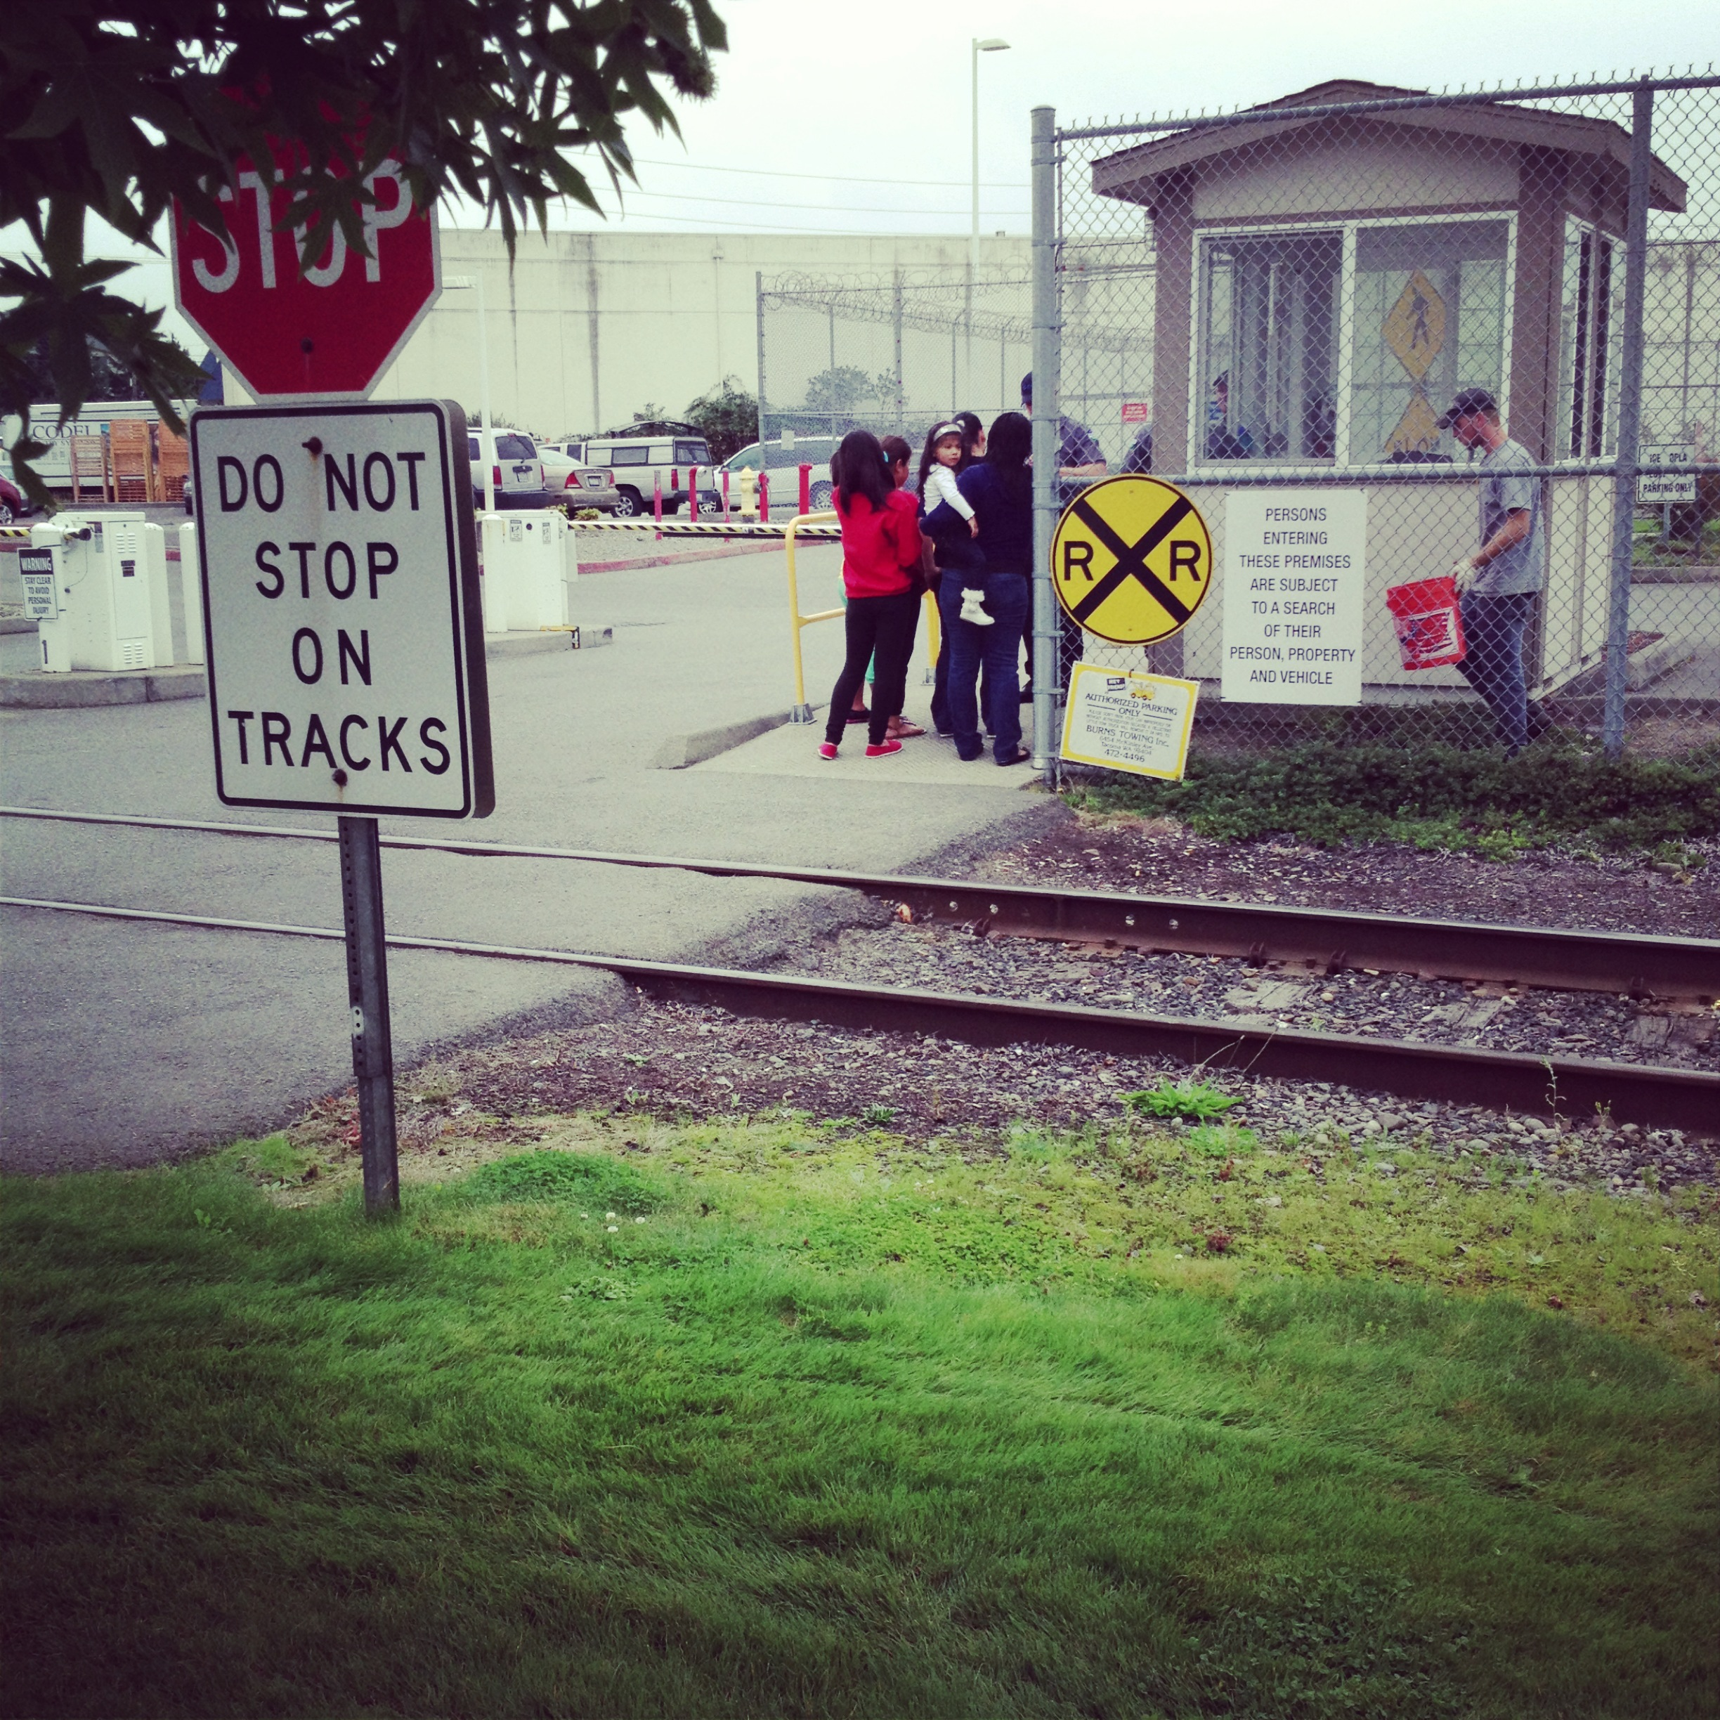
Northwest Detention Center

Slide 23
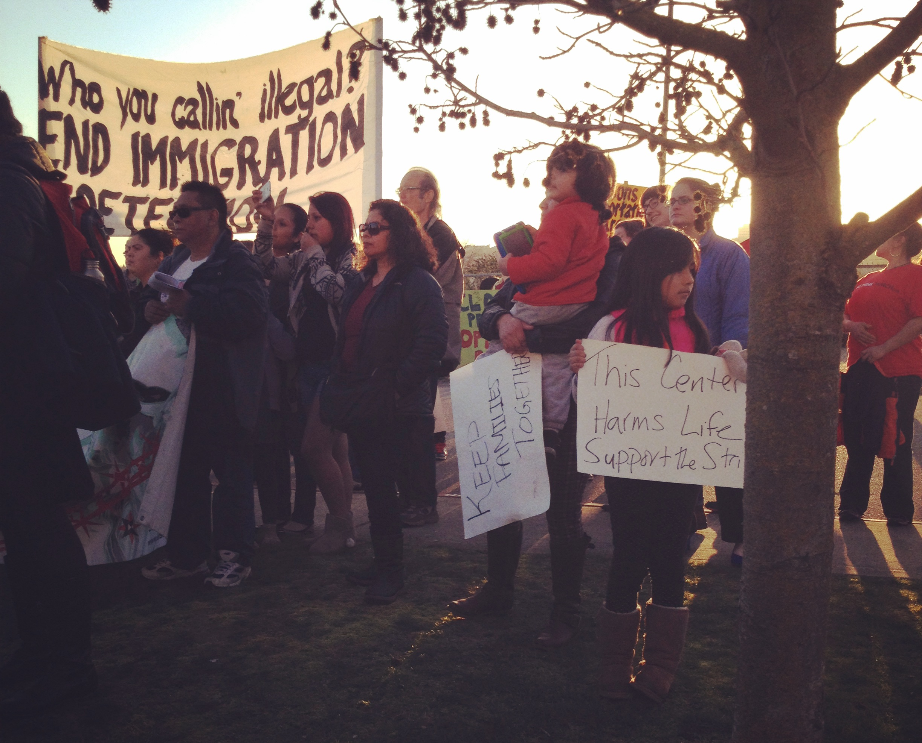
Support for “Huelgistas de Hambre” (Hunger Strikers)

Slide 24
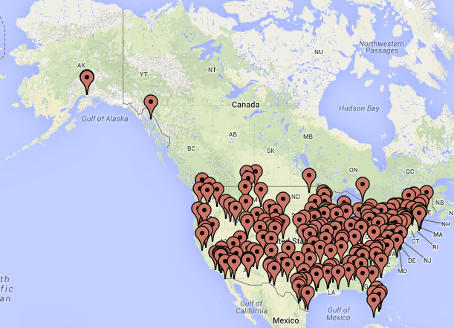
Immigrant Detention Centers in the United States

Slide 25
“We have serious concerns about for-profit prison companies because they are notorious for cutting essential costs that need to be provided to maintain a safe and constitutional environment for prisoners.”
– ACLU spokesperson as told to The Wall Street Journal, 2009

Slide 26
Contesting Needs-Based Approaches to Migration
Human rights cannot be “cherry picked”
Rights are by definition mutually reinforcing, universal, and indivisible
Projects in the name of “economic advancement” obscure how human rights are violated

